Slide 1






PRESENTATION 2026
Project Title: Closing the Feedback Loop: An Intelligent Student Feedback and Teaching Improvement System (SFTIA)
Faculty Name
Mentor Name
Faculty Email
Dr. Payal Shastri
Adarsh Sir
payal.shastri@hlcollege.edu

Slide 2

Outline
Abstract of the Project
Problem Statement
Proposed Solution
System Architecture
Live Demo of the Project
Embedded Video of Project
Conclusion
Future Scope

Slide 3
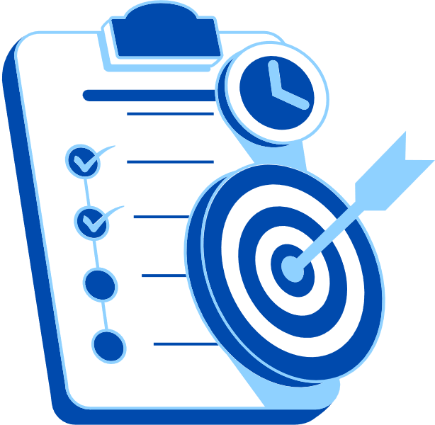
Abstract
This project is an End-to-end Faculty Feedback and Analytics System for the feedback received for 200 students’ responses, for 8 faculties, across 3 Courses and 10 parameters.
The objective of this project is to transform the raw feedback data into actionable and interpretable academic intelligence through data processing, visual analytics, and AI interaction by democratise feedback access for faculty, admin, students.
The tools and Techniques used for this project is - Microsoft Excel for data pre-processing & 4-sheet analytics workbook and Microsoft Copilot Studio - AI chatbot for Information Layer and Suggestions Layer.
The Expected outcome of this project is - Interactive Excel dashboard for better data interpretations, AI chatbot for answering scores + comment queries in simple & plain language as well as a Faculty suggestions module with personalised improvement plans which can extend upto 30 days faculty improvement plans.
The key highlights of this project is “A Smart Architecture with Excel Dashboards + Chatbot AI.”

Slide 4

Problem Statement
The core problem is - Student feedback data is scattered & remains unused after collection - institutions collect hundreds of responses per semester but lack tools to extract meaningful insight from them. Feedback is stored in Excel with no visualization, and no connection to faculty improvement planning. Qualitative comments are completely ignored - never read, categorized, or acted upon at scale.
This is significant because the massive volume of actionable data that is currently untouched, without analysis; weak faculty go unsupported, strong faculty go unrecognized, and institutional teaching quality stagnates semester after semester.
Faculty members receive no structured feedback on specific teaching dimensions or improvement pathways. Academic administrators make appraisal decisions without objective, data-backed evidence. External stakeholders such as: accreditation bodies & industry partners get transparent view of teaching quality metrics

Slide 5

Proposed Solution
The solution is a three-tier intelligent analytics system - combining structured data analytics, interactive visual dashboards, and an AI-powered conversational agent to transform raw student feedback into real-time, actionable academic intelligence
Tier 1 - Excel Analytics: Pre-processed dataset of responses across 6 structured sheets - faculty performance matrix, course-wise scores, year-wise and semester-wise comparison tables with delta indicators
Tier 2 - AI Chatbot (Copilot Studio): Natural language agent trained on all CSV data files - answers both quantitative queries (scores, rankings) and qualitative queries (comment summaries, sentiment breakdowns).
Tier 3 - AI Chatbot (Copilot Studio) - Coaching Layer: When a faculty member asks about their feedback, the bot automatically identifies weak areas, asks "Would you like improvement suggestions?", and delivers 4–5 specific, classroom-ready improvement strategies per weak dimension.

Slide 6
System Architecture
Data Input / Source
Processing / Analysis
200 student feedback responses (CSV), Excel workbook –10 quantitative score, Qualitative student comments with sentiment labels, faculty name, type of faculty, type of courses - B.Com, BBA, BCA, two years, and four semester.
Data cleaning and Custom column: Average_Score across all 10 dimensions; Sentiment classification: Positive / Negative tagging; Comment categorisation across 13 categories and all dimensions; Year-wise and semester-wise delta calculations (Δ scores) for comparison.
AI / Tool Integration
Output / Dashboard
Microsoft Excel - interactive dashboard; Microsoft Co-pilot Studio - AI conversational agent
3 CSV knowledge sources uploaded to Co-pilot Studio
for creating Coaching layer: weak area detection + suggestion engine.
AI Chatbot: natural language answers to any feedback query.
Faculty coaching: personalised 30-day improvement plans.
Export: PDF snapshots + Power BI Service shareable link
Audience: faculty, admin, students, external stakeholders

Slide 7
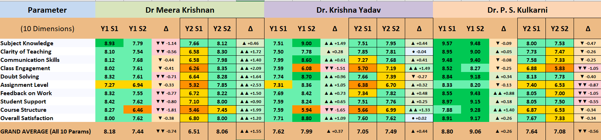
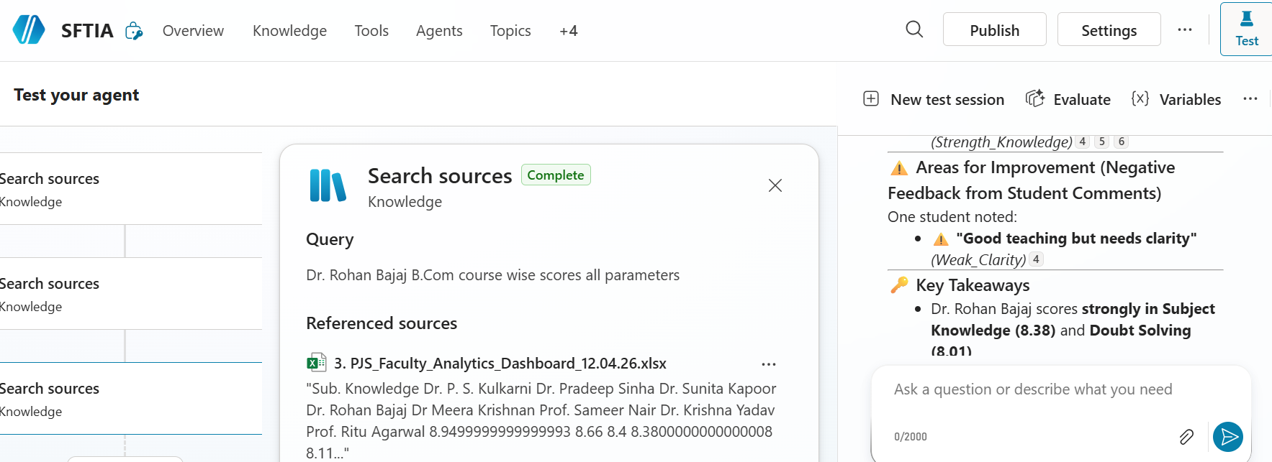
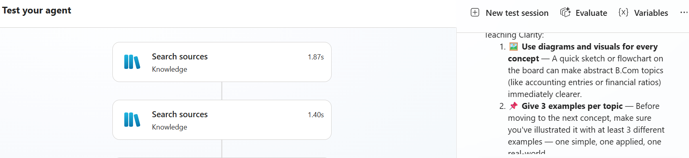
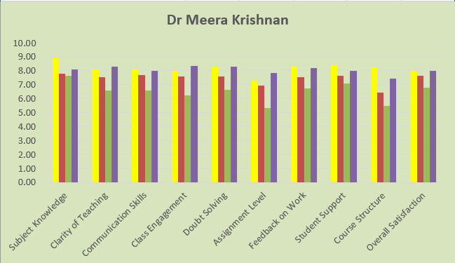
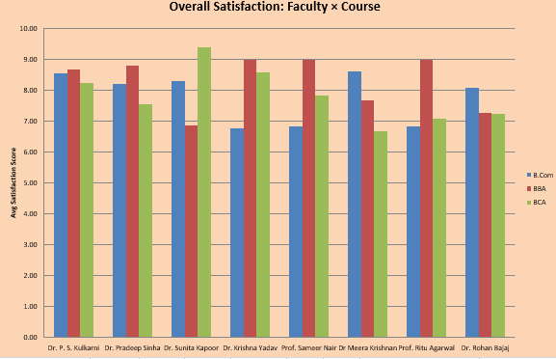
Live Demo of Project
Here's the list of some demo screenshots / features of the project:
Excel Dashboard
Interactive AI-Chatbot
Suggestive
AI-Chatbot
Demo 1
Demo 2
Demo 3

Slide 8
Video of Project Demo
[https://your-project-demo-link.com]
▶
[Insert your project demo video.
You can embed a video your live project.]

Slide 9

Conclusion
The key findings of this project is successfully designed & deployed a complete end-to-end Faculty Feedback Analytics System covering data processing, visual intelligence, and AI-powered interaction from raw CSV to live chatbot.
Built an 4-page interactive Excel dashboard providing visual insights into faculty performance, sentiment trends, comment patterns, and year-on-year and semester-on-semester score for 8 faculties across 3 Programs - B.Com, BBA, and BCA.
Developed an AI chatbot agent on Microsoft Copilot Studio capable of answering both quantitative and qualitative feedback queries in plain English, accessible to all stakeholders without any technical knowledge.
Created the first-ever faculty coaching module embedded within a feedback system – that is – the bot will identifying 6 weak teaching dimensions and deliver personalized, evidence-based improvement strategies to faculty and also help with 30-days strategy plan development.

Slide 10

Future Scope
Real-time feedback Integration: Connect the system to a live Google Form or Microsoft Form so student responses feed directly into the Excel Dashboard and /or Power BI dashboard and chatbot without any manual CSV export.
Multilingual chatbot support: Extend the AI agent to accept and respond in regional languages: Hindi, Gujarati, etc. making it accessible to a broader range of faculty and students across institutions.
Predictive analytics layer: Use historical semester data to build a ML model that predicts which faculty are at risk of score decline in the next semester enabling proactive intervention before results drop.
Voice-enabled chatbot: Integrate speech-to-text so faculty can verbally ask feedback questions making the system hands-free and accessible on mobile devices

Slide 11
Thank You
AICW Fellowship | Student Project Presentation 2026
LinkedIn | Edunet Foundation

